Slide 1
Collection Mini-Game

Slide 2
LECTURE GOALS AND OUTCOMES
The goals of this lecture are to
Implement a simple game
Show how to use a Game Mode class to define the rules of a game
Provide examples of how to use macros, custom events, and functions
Demonstrate the use of Timers in a game
Use Inheritance to create a collection of items to be picked up
By the end of this lecture you will be able to
Convert the rules of a game into Blueprint code
Organize code into macros, custom events, and functions
Draw some information using the HUD class
Define Timers using functions or custom events
Know how to inherit from classes you create
Change the behavior of child classes by overriding functions

Slide 3
GAME RULES
The player must collects as many items as possible before time runs out.
The initial time is set at 30 seconds.
The game is over when there is no time remaining.
There will be multiple classes of Collectible items
Each class will run its own logic on how it handles being picked up
Each class will award different number of points to the player
The time and score values will be drawn on the screen.

Slide 4
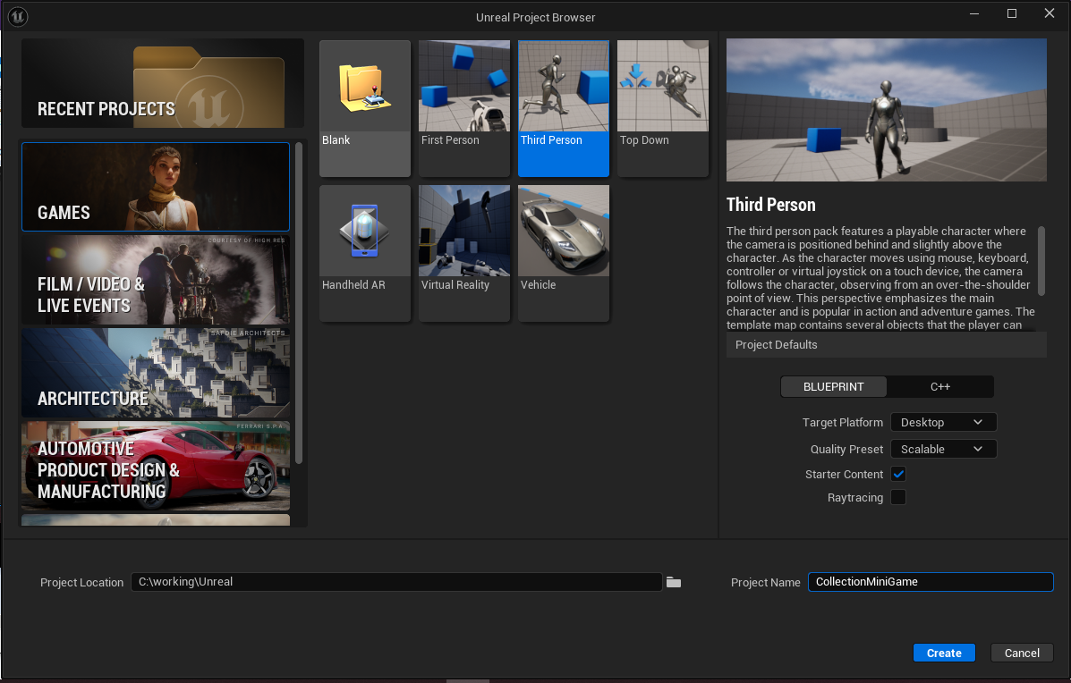
CREATING THE PROJECT
Create a new project using the Third Person template under the Games tab.
Template: Blueprint
Target Platform: Desktop
Quality Preset: Scalable
Starter Content : Selected
Raytracing: Unselected
Project Name: CollectionMiniGame
Project Location: Your Working Directory

Slide 5
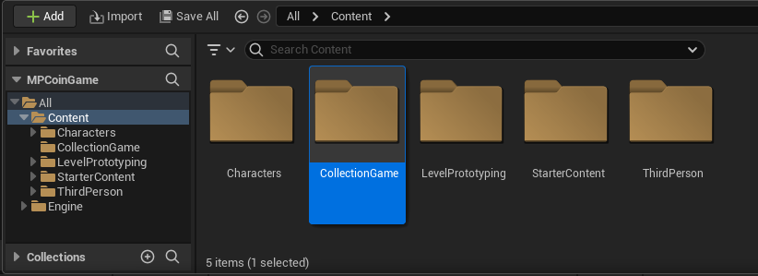
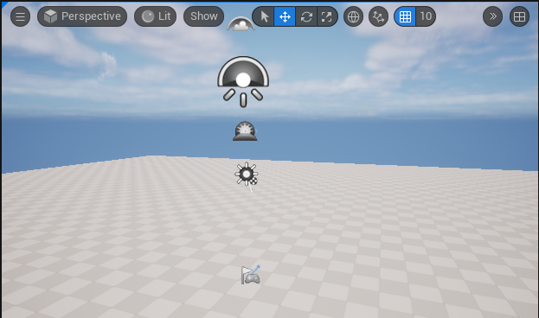
SETTING UP THE PROJECT
In the Content Browser, Create a new folder named “CollectionGame” at the root of the Content folder. This folder will store everything created for this project.
Create a new Map Top Menu: File -> New Map (CTRL-N) Select: Basic Save Map as File -> Save Current Level (CTRL-S) Save the Map as “CollectionGame”
Make sure to save the map file in the CollectionGame folder

Slide 6
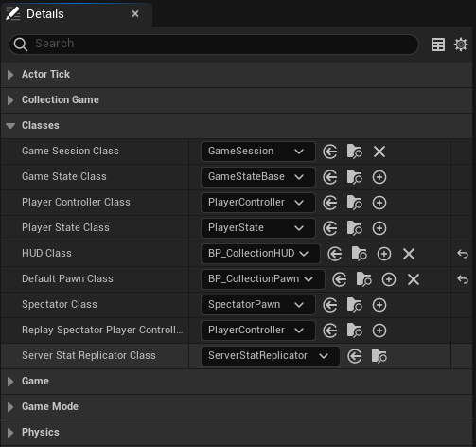
GAME CLASSES
The game uses four main Blueprint classes:
BP_CollectionGameMode: Controls the state of the game and stores some variables, such as those for time and score. It also defines the base classes,
BP_CollectionPawn: This is a copy of the BP_ThirdPersonCharacter blueprint from Third Person template folder. This class is assigned to the Default Pawn Class parameter of the game mode.
BP_CollectionHUD: Responsible for drawing the values of time or score on the screen. This class is assigned to the Hud Class parameter of the game mode
BP_Collectible: An Actor that is a collectible item. It checks for collision with the player and know what to do when collected. It is the parent class for all other collectible items created.

Slide 7
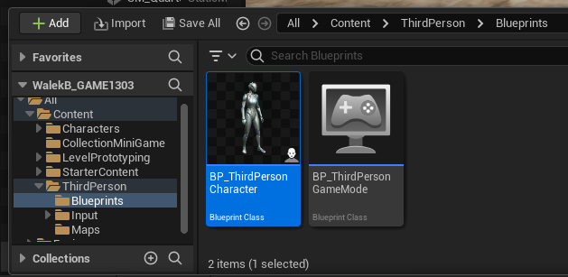
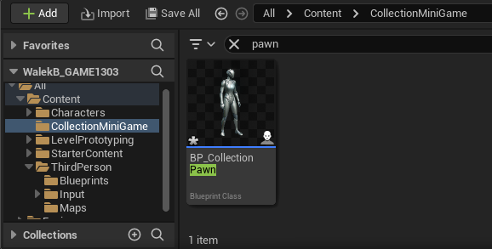
COPY THE DEFAULT PAWN
Go to the Blueprints Folder in the ThirdPerson Template.
Select the BP_ThirdPersonChracter and drag it to the CollectionMiniGame Folder.
Select to make a Copy of Blueprint.
Rename the Blueprint Copy to BP_CollectionPawn
This step is organizational. We could have just added to BP_ThirdPersonCharacter. Instead we’re using a blueprint class specific to the minigame and kept with all the other blueprint classes.

Slide 8
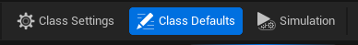
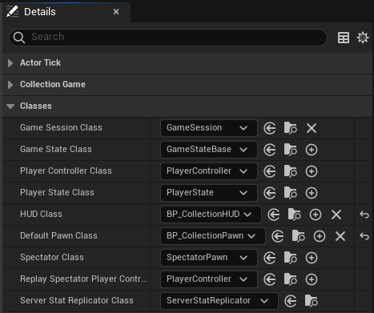
CREATE CORE CLASSES
Create Blueprint class: BP_Collectible Parent Class : Actor Add a Variable named “ScoreAwarded” Integer Type Instance Editable Default Value: 100
Create Blueprint class: BP_CollectionHUD Parent Class: HUD
Create Blueprint class: BP_CollectionGameMode • Click on Class Defaults button • Detail Panel: Classes • Default Pawn Class: BP_CollectionPawn • HUD Class: BP_CollectionHUD

Slide 9
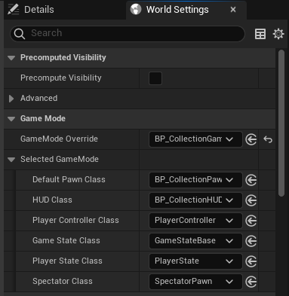
SET THE GAME MODE
Return to the CollectionGame Map, We are ready to assign the game mode to the map.
• Open the World Settings • Top Menu: Window -> World Settings
• Under the Game Mode Section, • GameMode Override: BP_CollectionGameMode
• Save the Map (CTRL-S)
Under Selected Game Mode you will see values for Default Pawn and HUD Class as assigned in BP_CollectionGame class.

Slide 10
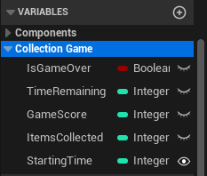
BP_CollectionGameMode
Variables
Create the following Boolean variable:
GameOver: Indicates if the game has ended.
Create the following Integer variables:
GameScore: Stores the player’s score.
ItemCollected: How many items collected
TimeRemaining: Stores the time remaining until the end of the game.
StartingTIme: The starting time of the game
This variable is Instance Editable
The Default Value is 30
All of the created variables have been assigned to a new category named “Collection Game”
Create and assign the category in the Details tab
Once the Category is created, You can drag and drop the variables in the Varible tab to assign them to the category.
Instance Editable Variables will appear on an Actor in the level on the Details panel under this category now.

Slide 11
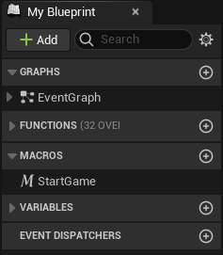
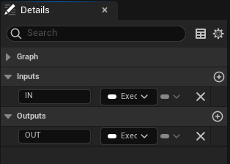
BP_CollectionGameMode
StartGame (Inputs/Outputs)
In the My Blueprint panel, create a macro named “StartGame”.
This macro is responsible for initializing the variables that control the state of the game.
In the Details panel for the StartGame macro,
Create an input parameter named “In” and set the type to “Exec”.
Create an output parameter named “Out” and set the type to “Exec”.

Slide 12
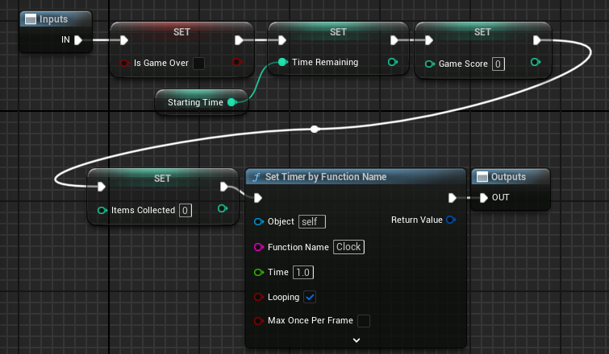
BP_CollectionGameMode: StartGame (Macro)
The StartGame macro will set the initial values of the variables.
Time Remaining is set via Starting Time Variable.
The Set Timer By Function Name function creates a Timer object that will call a custom event named “Clock” every 1.0 seconds. Make sure you set Looping to true!

Slide 13
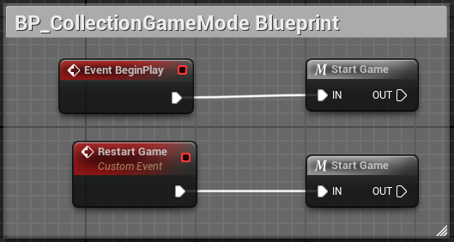
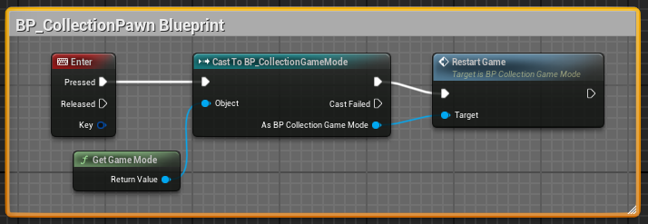
USING THE MACRO
The StartGame macro is called from the BeginPlay event in the BP_CollectionGameMode Blueprint.
A custom event named “RestartGame” was created. To create a custom event, right click in the Event Graph and select “Add Custom Event”. When this event is called, it also calls the StartGame macro
The RestartGame custom event is called from the BP_CollectionPawn Blueprint Event Graph. When the player presses the Enter key, use the Get Game Mode node. Use the Return Value to Cast to BP_CollectionGameMode.
As a reference in the correct class type, you can draw out a line to call the StartGame event.

Slide 14
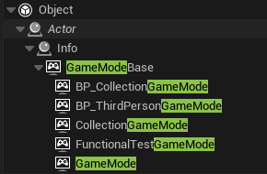
Inheritance:
Inheritance is an “IS” relationship
• Classes are also the types they inherit from.
BP_CollectionGameMode is a child class of GameModeBase, which inherits from Info, then from Actor, then from Unreal’s Object Class.
• A class can be assigned to a variable of a type it inherits from.
BP_CollectionGame can be stored in a variables of types of GameModeBase, Info, Actor, and Object.

Slide 15
Inheritance:
The Reference Type Matters
• An object reference has access to the variables, functions, methods, events defined to its class type.
This will include parent classes, but not of child classes. Child Classes are specializations of their parents.
The event RestartGame is defined in BP_CollectionGameMode. GameModeBase is a parent class, thus does know of or have access to RestartGame.
• Casting is the process to attempt to transform a reference type to an inherited child type
The Game Mode is casted to our Game Mode Type, We can then access the RestartGame event

Slide 16
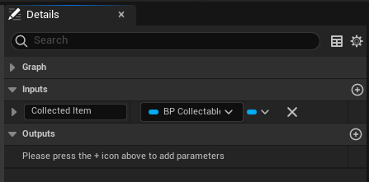
BP_CollectionGameMode
AddCollectedItem (function)
“AddCollectedItem” is a function in BP_CollectionGameMode that is called by the BP_Collectible class when the player picks up an item.
Add an INPUT named “Collected Item”
It is an object reference of the BP_Collectible class.
When the Item is picked up, It passes a reference of itself to calling node. We’ll see this in action in the BP_Collectible blueprint.
Use the reference of “Collected Item” to get access to the item’s ScoreAwarded value. Then Add that value to GameScore.
Finally Increment ItemsCollected by 1

Slide 17
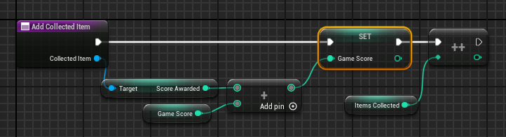
AddCollectedItem
Complete Function Graph
Above is the entire blueprint graph for the AddCollectedItem function
You can get access to Score Awarded in BP_Collectible by drawing a wire from Collected Item input.

Slide 18
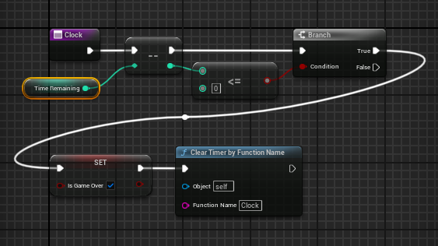
BP_CollectionGameMode: CLOCK (function)
Clock is a function that is called every second by the Timer. It has the following responsibilities:
To decrease by “1” the value of the Time Remaining variable
Check if the value of the Time Remaining is Less Than or Equal To value of “0”;
Use a IF (branch) Node, on “True”
Set the value of the Boolean GameOver variable to “true”
End the timer calling the Clock function with the node “Clear Timer by Function Name”

Slide 19
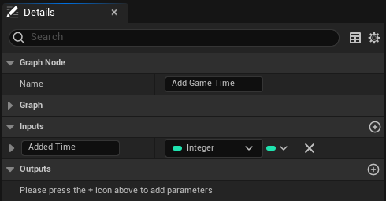
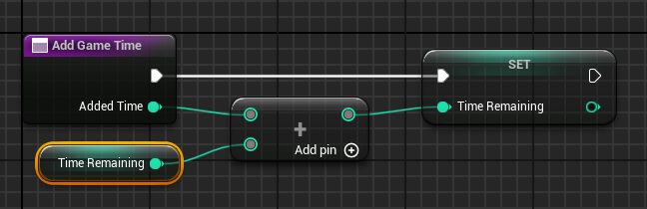
BP_CollectionGameMode: AddGameTime (function)
AddGameTime is a function that is being written now. It will be used later to implement one of the collectible item classes.
AddGameTime has one Input:
an integer named “TimeAdded”,
When the Function is called add “TimeAdded” to “Time Remaining”
Then assign the added value to “Time Remaining”

Slide 20
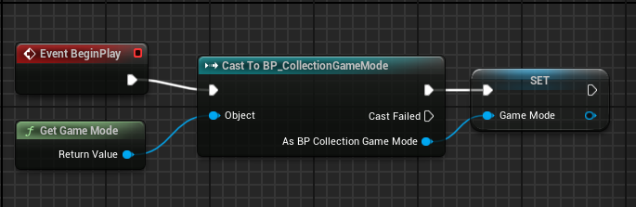
BP_CollectionHUD
Begin Play
Create a variable named “GameMode” of type of an Object Reference of “BP_CollectionGame”.
The image on the right shows the BeginPlay event getting a reference to the Game Mode, casting the reference to BP_CollectionGame, and saving that reference in the variable.
This reference will be used to easily access the variables that will be drawn on the screen.

Slide 21
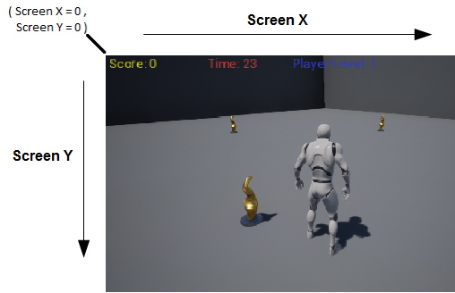
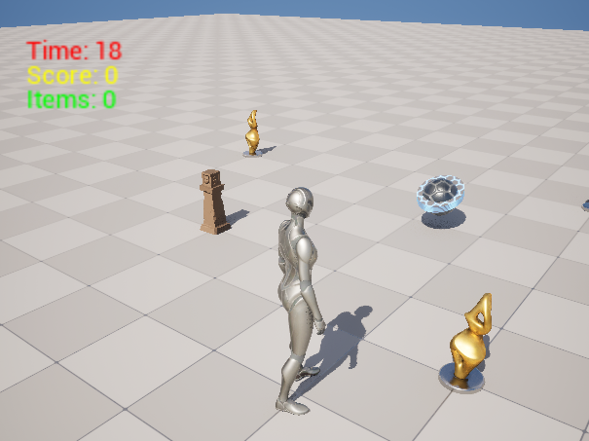
SCREEN COORDINATES
The only action that will be used to draw in this game is the Draw Text function. This function receives some input values, among them those for two parameters known as “Screen X” and “Screen Y”, which depend on the resolution of the screen. For example, 1280 x 720 is a common resolution.
These values represent the coordinates of the screen on which the text will be drawn. The top left position of the screen is the origin, where the values of Screen X and Screen Y are “0”, or (as a vector) <0,0>.
The image on the right shows how the values of these two parameters determine where text will be drawn.
We’ll start by drawing text away from the corner. This will be about at <30, 50>

Slide 22
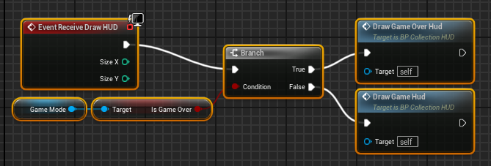
BP_CollectionHUD:
RECEIVE DRAW HUD
To draw on the screen, the Receive Draw HUD event must be added to the Event Graph. This event is available only in Blueprints based on the HUD class.
Our HUD will be drawing two things. The state of the game and if the game is over. Create a functions for each part • DrawGameHUD • DrawGameOverHUD
Use the Game Mode reference to get the IsGameOver boolean. Use this boolean with an IF (branch) to control which function is called.
In the future, You’ll create more more robust HUD classes by creating and managing UMG Widgets to be drawn on the screen.

Slide 23
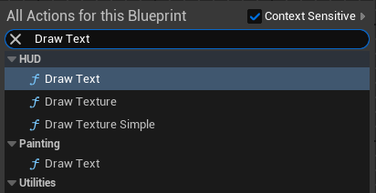
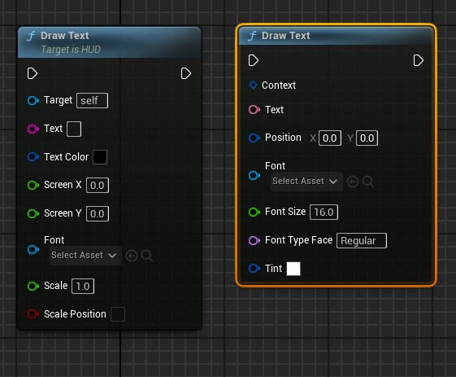
Draw Text
There are multiple Draw Text nodes that are available to for us. There’s only one we want to use here and it’s a function of the HUD class. This is the node highlighted in the upper image
The correct node can be identified because it displays “Target is HUD” under Draw Text at the top.
The other Draw Text Node is a function of the Painting Class. You may select this by accident. You can recognize this node by: • “Target is HUD” is not displayed under Draw Text • The node will have a pin for a “Context” variable
The lower image shows both nodes to show the differences between them and help identify each node
The wrong node has an input pin for “Context”
The correct node has “Target is HUD” under Draw Text

Slide 24
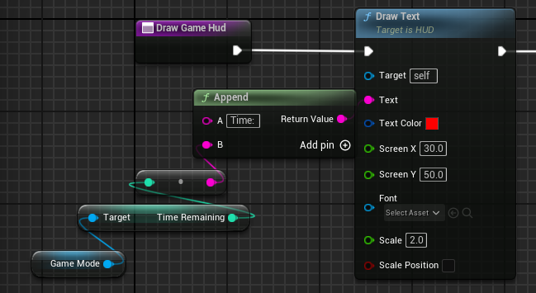
BP_CollectionHUD:
DrawGameHUD
Time
Time Will be the first text well draw. Wire a Draw Text node from the function input Exec pin.
We’ll use an append node to build a string so that it will appear as “Time: ##”, where the ## in the string will be value.
Text: From Append Node A: “Time: “ Don’t forget the space after the ‘:’ in the string B: Value of Time Remaining Use the HUD’s Game Mode reference to get this variable Text Color: Red <RGB: 1, 0, 0> Screen X: 30 Screen Y: 50 Scale: 2.0
If Font is left unselected, a default font will be used automatically.

Slide 25
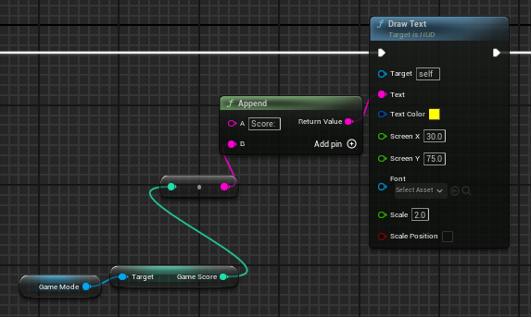
BP_CollectionHUD:
DrawGameHUD
Score
Score will be drawn second. Wire a new Draw Text node from Draw Text Node use to draw Time on screen.
We’ll use an append node to build a string so that it will appear as “Score: ##”, where the ## in the string will be value.
Text: From Append Node A: “Score: “ Don’t forget the space after the ‘:’ in the string B: Value of Game Score Use the HUD’s Game Mode reference to get this variable Text Color: Yellow <RGB: 1, 1, 0> Screen X: 30 Screen Y: 75 Scale: 2.0
If Font is left unselected, a default font will be used automatically.

Slide 26
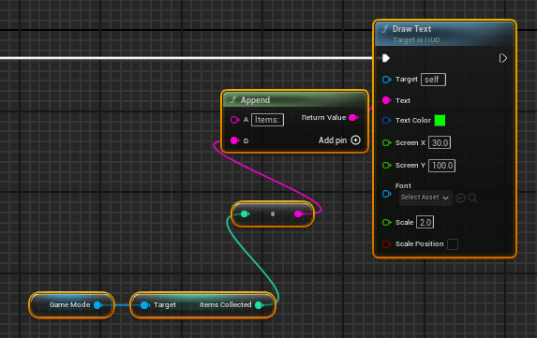
BP_CollectionHUD:
DrawGameHUD
Items
Items will be drawn last. Wire a new Draw Text node from Draw Text Node use to draw Score on screen.
We’ll use an append node to build a string so that it will appear as “Items: ##”, where the ## in the string will be value.
Text: From Append Node A: “Items: “ Don’t forget the space after the ‘:’ in the string B: Value of Game Score Use the HUD’s Game Mode reference to get this variable Text Color: Green <RGB: 0, 0, 1> Screen X: 30 Screen Y: 100 Scale: 2.0
If Font is left unselected, a default font will be used automatically.

Slide 27
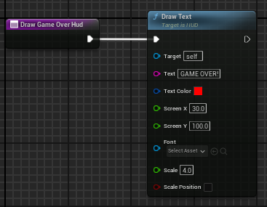
BP_CollectionHUD:
DrawGameOverHUD
There’s only a single string to write to the screen here. Wire a Draw Text node from the function input Exec pin.
Text: “GAME OVER!” Text Color: Red <RGB: 1, 0, 0> Screen X: 30 Screen Y: 50 Scale: 2.0
If Font is left unselected, a default font will be used automatically.

Slide 28
LET’S TEST!
Let’s return to the Collection Game Map.
• Save and Run the map!
If everything is setup correctly: • The HUD will draw on screen • The timer decreases in value. • “GAME OVER!” displays when Time reaches 0. • Hitting enter will restart the game • Time will return back to 30 on reset
Don’t worry about the Score and Items values. The Collectible Classes haven’t been built yet.

Slide 29
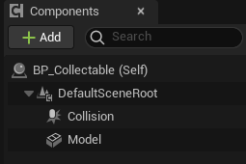
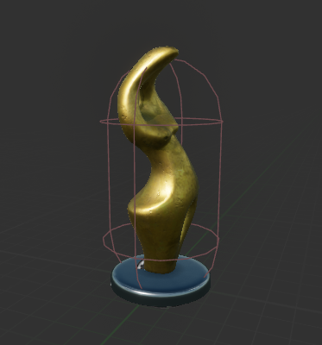
BP_Collectible: Actor Setup
• Static Mesh Component Name: “Model” Static Mesh: SM_Statue Materials: Element 0: M_Metal_Gold Element 1: M_Statue The statue mesh is assigned a glass texture to it, we’ll override that here with a gold material to make it easier to see. Collision Preset: “No Collision”
• Capsule Collision Name: “Collision” Location: <0.0, 0.0, 40.0> Collision Preset: “OverlapAllDynamic”
• “Score Awarded” variable This was added immediately when we made this class to enable us to write the AddCollectedItem function in the BP_CollectionGameMode class

Slide 30
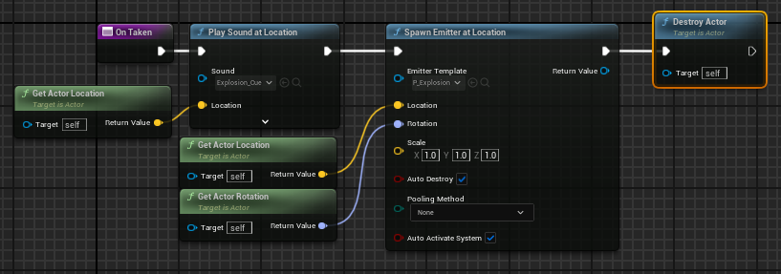
BP_Collectible: OnTaken
OnTaken’s role is to be available to be overridden in children of the BP_Collectible class to control how each child item behaves.
The BP_Collectible version of OnTaken will • Play an the explosion sound • Spawn an explosion emitter • Removes the actor

Slide 31
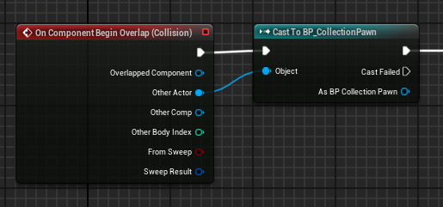
BP_Collectible: ACTOR BEGIN OVERLAP (1/2)
Your Collectible item will react to object that are overlapping the Collision component.
Click on the Collision component and add “On Component Begin Overlap” to the event Graph.
When another actor overlaps, the first thing to do is to check if it is an instance of our Default Pawn, BP_CollectionPawn.
To do this, we’ll cast the Other Actor reference to BP_CollectionPawn. If it succeeds, we continue,
If the cast fails, it’s an actor of another type and we can ignore it.

Slide 32
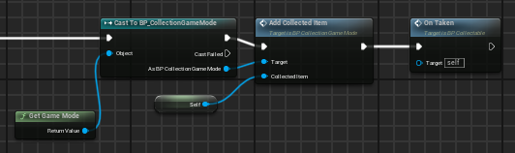
BP_Collectible: ACTOR BEGIN OVERLAP (2/2)
Now that we know that we are dealing with a Default pawn, we need to do the following
• Get the Game Mode • Cast the Game Mode to BP_CollectionGame • With the casted reference, call the function AddCollectedItem • AddCollectedItem takes a Collectible Reference, this will be item’s reference using a reference of “Self” • Call the Class’s OnTaken function

Slide 33
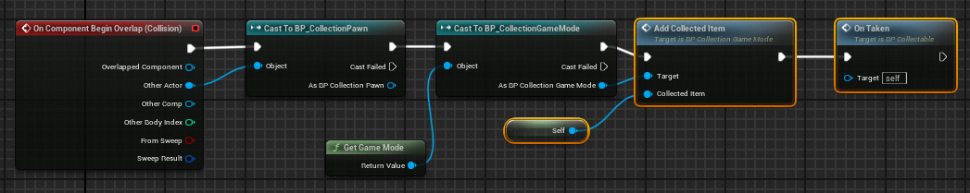
BP_Collectible ACTOR BEGIN OVERLAP
Complete BluePrint Graph
With this complete, the core of how Collectible items perform is complete.
All that is left is how Items react via the OnTaken function

Slide 34
LET’S TEST!
Let’s return to the Collection Game Map.
• Place about 5 or 6 instances of BP_Collectible into the map • Save the Map and Run It.
• If everything is set up correctly… • You’ll be able to pick up the items • The items will “explode” and disappear • Value of Score and Items will increase • Resetting the game sets value of Score and Items back to ‘0’ • It was doing this already, but we can test this now

Slide 35
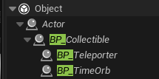
Inheritance: Child Classes
Now that we have BP_Collectible working, we have our core collectible item class.
Let’s use it to build two children classes that will different behavior: • BP_Teleporter • BP_TimeOrb
To create a child class of a blueprint class we’ve created, right click on the class and select “Create Child Blueprint Class”

Slide 36
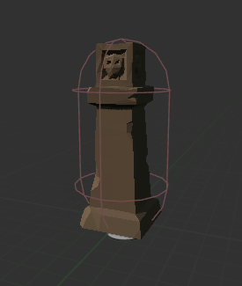
BP_Teleporter: Actor Setup
Create a new blueprint class from BP_Collectible
Import the provided fbx file. Set the model’s Static Mesh to the imported mesh: SM_ENV_Pillar_Square_04
This model is very small, you will need to scale it up by factor of 35, or <35.0, 35.0, 35.0> in the Model’s Scale value.
The material applied to the model is M_Metal_Rust
Functions: • OnTaken (via function override) • Create TeleportObject • Create GetRandomSign

Slide 37
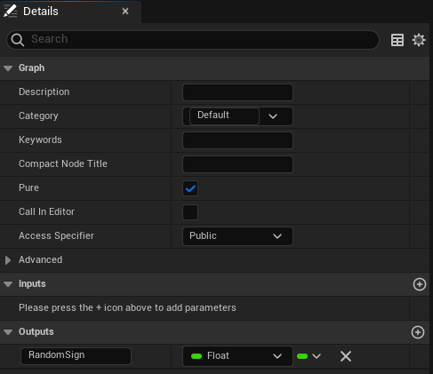
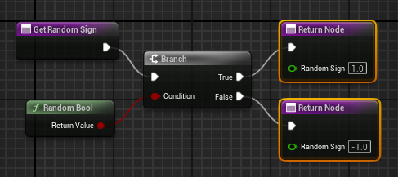
BP_Teleporter: GetRandomSign
GetRandomSign is a utility function to get a 1 or -1 value. • Add an Output • Float type named “Random Sign” • Select “Pure” • The node will just return an the output value • The node won’t have to be wired into the exec
Select the Return Node in the graph and then use Copy (CTRL-C) and Paste (CTRL-V) to get a second Return Node.
We can use the Random Bool node and plug that in to and IF (branch) node.
The IF (branch) node will wire to two different return nodes. • True: Wire to Return Node with “1.0” value • False: Wire to Return Node with “-1.0” value

Slide 38
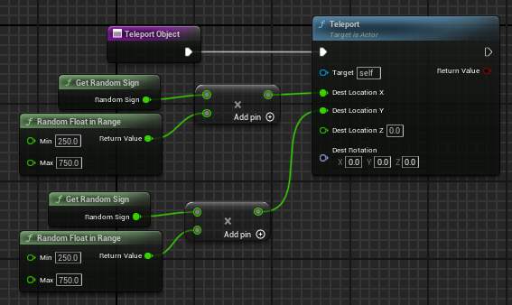
BP_Teleporter: TeleportObject
The TeleportObject function currently only moves the object in a ring around the map’s Origin <0,0,0> on the Z-Plane at 0. • Your level designers will grumb at this. • Revisit this later to improve for more use cases!
The Function calls the Teleport node.
Right Click on “Dest Location” and use “Split Struct Pin” to get access to X,Y,Z components of the Vector3.
Set Values of Destination Location X and Y • Random Float in Range: 250 to 750 • Multiplies the value by 1 or -1 from GetRandomSign function • This random sign call places the object around the origin.

Slide 39
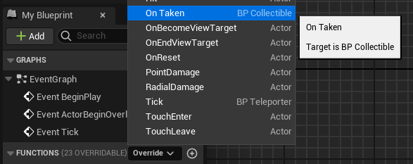
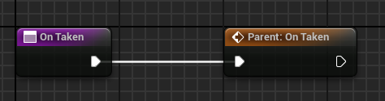
Function Overriding
To override a function in Unreal: • Put your cursor next to the ‘+’ button to add a function. • A dropdown menu label “Override” will appear. • Click on the Dropdown menu to open it • Select the function you wish to override.
When you open the Function Graph, • you will be given a new version of the function. • By default it will provide a link to use the Parent’s version of the function.

Slide 40
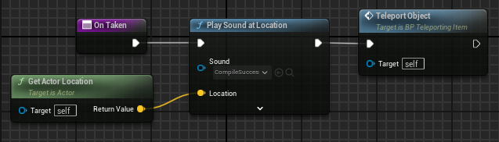
BP_Teleporter: OnTaken (Function Override)
BP_Teleporter’s version of OnTaken, we are completely overriding everything the function is doing.
• Delete the Parent:On Taken Node • Play a Sound at the Actor’s Location • Calls the TeleportObject function

Slide 41
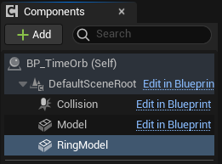
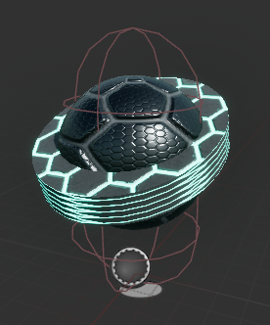
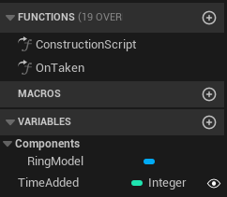
BP_TimeOrb: Actor Setup
This item adds game time when picked up.
Model (Static Mesh Inherited from BP_Collectible) Static Mesh: Shape_Sphere Material: M_Tech_Hex_Tile Location <0.0, 0.0, 20> Scale <0.5, 0.5, 0.5>
ModelRing (Static Mesh added to this class) Static Mesh: Cylinder Material: M_Tech_Hex_Tile_Pulse Location <0.0, 0.0, 50> Rotation <0.0, 20.0, 0.0> Scale <0.7, 0.7, 0.1>
Add Variable named “TimeAdded” Integer type, Instance Editable, Default Value: 5

Slide 42
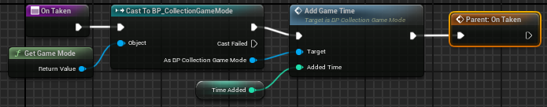
BP_TimeOrb: OnTaken (Function Override)
BP_TimeOrb OnTaken version adds to what BP_Collectible does. So don’t delete Parent: OnTaken node, but break the link to it.
• Gets the Game Mode • Casts the Game Mode Reference to BP_CollectionGameMode
• Uses the Casted reference to call the AddGameTime function. • AddGameTIme call is passed TimeAdded variable • Calls the Parent: OnTaken function • This Calls BP_Collectible’s version of OnTaken • This will explode the object and remove it.

Slide 43
LET’S TEST!
Let’s return to the Collection Game Map.
• Place 3 instances of the BP_TimeOrb in the map • Place 5 instances of the BP_Teleporter into the map •Save the Map and Run It.
If everything is set up correctly… • Time orbs items explode and add time • Teleporter items will move to a new location • Teleporters can score twice when picked up • Don’t worry about this bug right now.

Slide 44
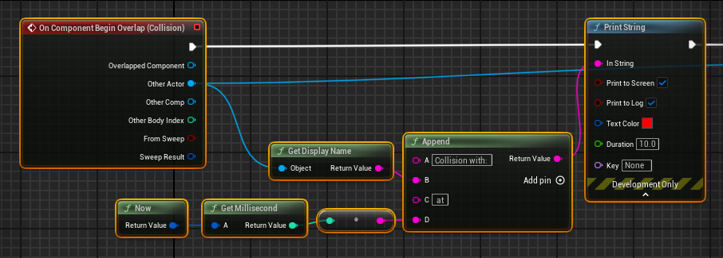

BP_Teleporter:
Debugging The Problem
So far we know that when the teleporter object is taken, the collision code is called twice.
The fix needs to take place in the BP_Collectible, so that all children have the fix.
To help us understand what is going on, let’s print out information • Display Name of What Collided • Time Now In Milliseconds Use an Append node to format the string to print.
When we test and take an instance of BP_Teleporter, we’ll see the it collision happens twice on the same frame.

Slide 45

BP_Teleporter:
Print Collision Info (function)
Let’s take all those nodes that print the collision information and collect it into its own function.
Remember to add an input of type Actor Reference so we can wire in which actor collided with this object.

Slide 46

BP_Teleporter:
Building a Solution
The double trigger issue wasn’t happening in BP_Collectible and BP_TimeOrb because the object is getting removed when picked up. This prevents the second collision trigger from happening.
BP_Teleporter, doesn’t get removed. Thus to fix the problem we have to ensure the collision code is only be run once in a single frame.
We’ll use the Do Once Node to control that functionality.
The next gameplay frame will happen On Tick. We’ll use that node to reset the Do Once node.

Slide 47
LET’S TEST!
Let’s return to the Collection Game Map.
You made a fix in the Parent class of BP_Collectible that made sure collisions code is run only once each frame. Thus, all the items are already in the map
Run the Map!
If everything is set up correctly… • Teleporter items will move to a new location • But only call their code once each frame.

Slide 48

SUMMARY
A simple collection mini-game was implemented to show how classes interact with each other in a game.
The Game Mode was used to define the game rules and uses logic to enforce those rules.
The HUD class was used to draw some information on screen.
A collectible class was created as our core parent class for all items in the map. It was then inherited by children classes. This game uses macros, custom events, functions, and timers. Function overriding was used to change the behavior of children collectibles.

